Slide 1

A VIETNAMESE RESTAURANT IN TORONTO

Slide 2
June 18, 2021

Slide 3

INTRODUCTION

Slide 4
Background
Toronto is one of the most densely populated areas in Canada
Being the largest city in Canada with an estimated population of over 6 million, there is no doubt about the diversity of the population
Moreover, Toronto is the most destination in Canada for international students from multi cultures such as Vietnam, China, Japanese, Korea and many more

Slide 5
Problem
Through this project, we will find the most suitable location for an entrepreneur to open a new Vietnamese restaurant in Toronto, Canada

Slide 6

Problem
Interest

Slide 7
DATA OVERVIEW
The data that will be required will be a combination of CSV files that have been prepared for the purposes of the analysis from multiple sources which will provide the list of neighborhoods in Toronto , the Geographical location of the neighborhoods and Venue data pertaining to Asia restaurants
The Venue data will help find which neighborhood is best suitable to open an Vietnamese restaurant

Slide 8
Wikipedia
This source contains information about all boroughs and neighborhoods with corresponding postal code via the table
I need to implement some web scraping techniques to scrap the data then process and store it into DataFrame

Slide 9
Geocoder package
I don’t use the package, but a CSV file that provided in the previous lab will be used
Then, merging it with Neighborhoods DataFrame to get the fully table

Slide 10
Foursquare API
This source is used for getting nearby venues at each neighborhood
After that, cleansing it a little bit and merging to get the final DataFrame

Slide 11
METHODOLOGY
Data Preprocessing / Data Cleansing
Toronto Neighborhoods

Slide 12
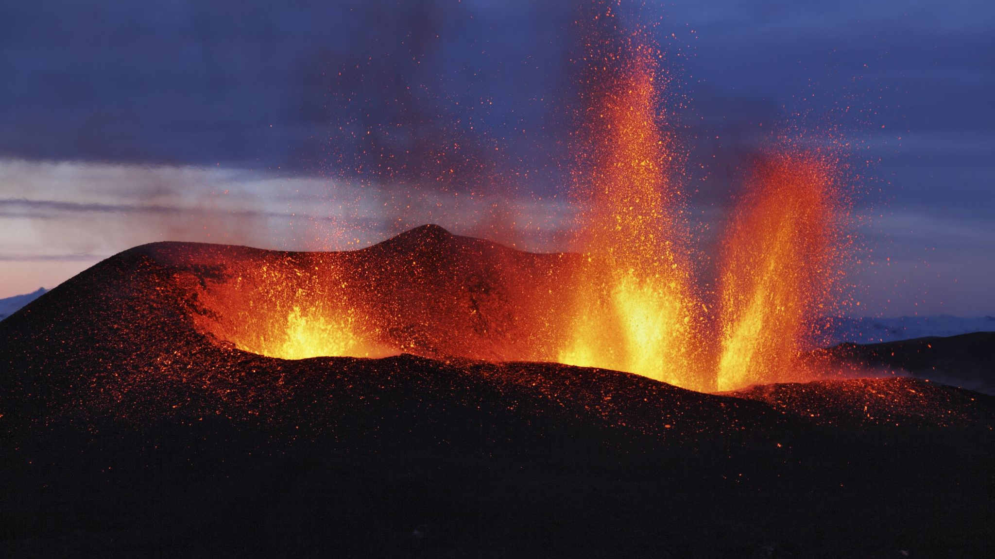
METHODOLOGY
Toronto Venues One-hot

Slide 13
METHODOLOGY
Vietnamese Restaurants Neighborhoods

Slide 14

METHODOLOGY
Asia Restaurants Freq/Sum Neighborhoods

Slide 15
Data Exploration
Drawing
Drawing Toronto map and marking all neighborhoods on the map
Drawing
Drawing Toronto map and marking all neighborhoods have at least one Vietnamese restaurant

Slide 16
Data Exploration
Before diving into those things, I would like to answer you guys a question: How do I draw the map?
Toronto Neighborhoods

Slide 17
Data Exploration
Neighborhoods have Vietnamese Restaurants

Slide 18
Machine Learning
As mentioned above, I would use Asia Restaurants Freq DataFrame for Machine Learning
To make the analysis more interesting, we wanted to cluster the neighborhoods based on the neighborhoods that had similar averages of Asia Restaurants in that Neighborhood
To get our optimum K value that was neither overfitting or underfitting the model, we used the Elbow Point Technique
In this technique, we ran a test with different number of K values and measured the accuracy and then chose the best K value
Neighborhoods that had a similar mean frequency of Asia Restaurants were divided into 7 clusters

Slide 19
Data Analyst
I eliminate all clusters which only have either 1 or 2 Neighborhoods
After cleansing a little bit, there are 4 clusters remain: 0, 1, 3
If you want to take a look at the others clusters, try to see my notebook

Slide 20
Cluster 0
There are 69 Neighborhoods in this cluster that are scattered distribution over Toronto
To get more insights, I try to plot the bar chart that shows number of each Restaurant’s types in this cluster
As the bar chart showing, I can clearly see that there is no Vietnamese Restaurant in this cluster, and this cluster has diverse types of restaurants
So, it may be a desirable choice for our new business

Slide 21
Cluster 1
In this cluster 1, it only has 4 neighborhoods that have only one type of restaurants: Chinese Restaurant
So, there is no doubt about this cluster can be called Chinese Cluster
In addition, there are no Vietnamese restaurants here and similar in Vietnamese and China cuisine make this cluster becomes a quite desirable choice for our business

Slide 22
Cluster 3
Just like the Chinese cluster, this cluster can be called the Thai cluster because it has Thai restaurants at most

Slide 23
Cluster 4
This cluster rounds up Downtown Toronto, and it has 18 neighborhoods in total
These number of each type of restaurants seem to be high because these neighborhoods near the other

Slide 24
CONCLUSION
In conclusion, to end off this project, we had an opportunity on a business problem, and it was tackled in a way that it was similar to how a genuine data scientist would do
We utilized numerous Python libraries to fetch the information, control the content and break down and visualize those datasets
We have utilized Foursquare API to investigate the settings in neighborhoods of Toronto, get a great measure of data from Wikipedia which we scraped with the BeautifulSoup Web scraping Library
We also visualized utilizing different plots present in seaborn and Matplotlib libraries

